Slide 1
Looking inside Computer I/O Devices
By Liam Osman

Slide 2
Agenda
USB
Versions
Encoding
Serial vs. Parallel
Pinout
Digital Input
Mouse
Keyboard
Digital Output
Displays
Analog Audio
Speakers
Microphones
Conclusion

Slide 3
USB

Slide 4
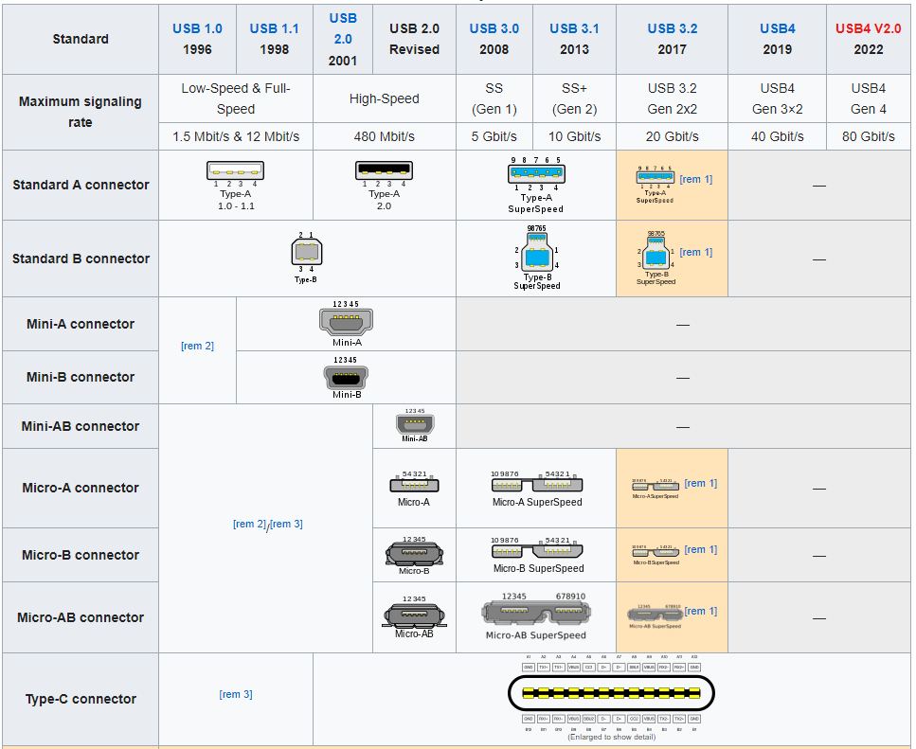
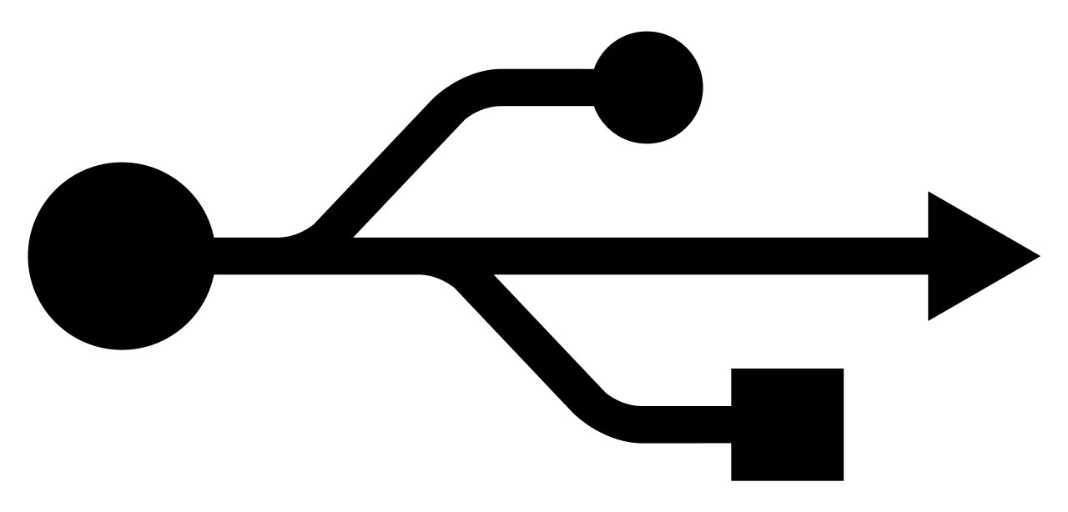
USB Versions
Multiple Connectors
Multiple Protocols
USB A & C connecters are most used
From https://en.wikipedia.org/wiki/USB

Slide 5
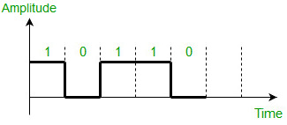
Binary Signals
Computers can only work in binary numbers, not decimal
The simplest way of implementing this is 1 = high, 0 = low
Voltage is changed to match
10110₂
= 2^4 + 2^2 + 2^1
= 22₁₀
https://www.geeksforgeeks.org/difference-between-unipolar-polar-and-bipolar-line-coding-schemes/#

Slide 6
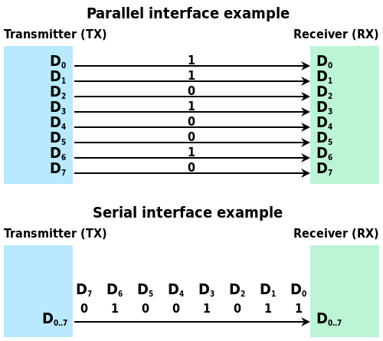
Serial vs. Parallel
Serial
Parallel
Uses 1 data line
Cheaper construction
Less crosstalk
No clock skew
Uses many data lines
More data per clock
No processing at beginning and end
https://commons.wikimedia.org/wiki/File:Serial_and_Parallel_Data_Transmission.svg

Slide 7
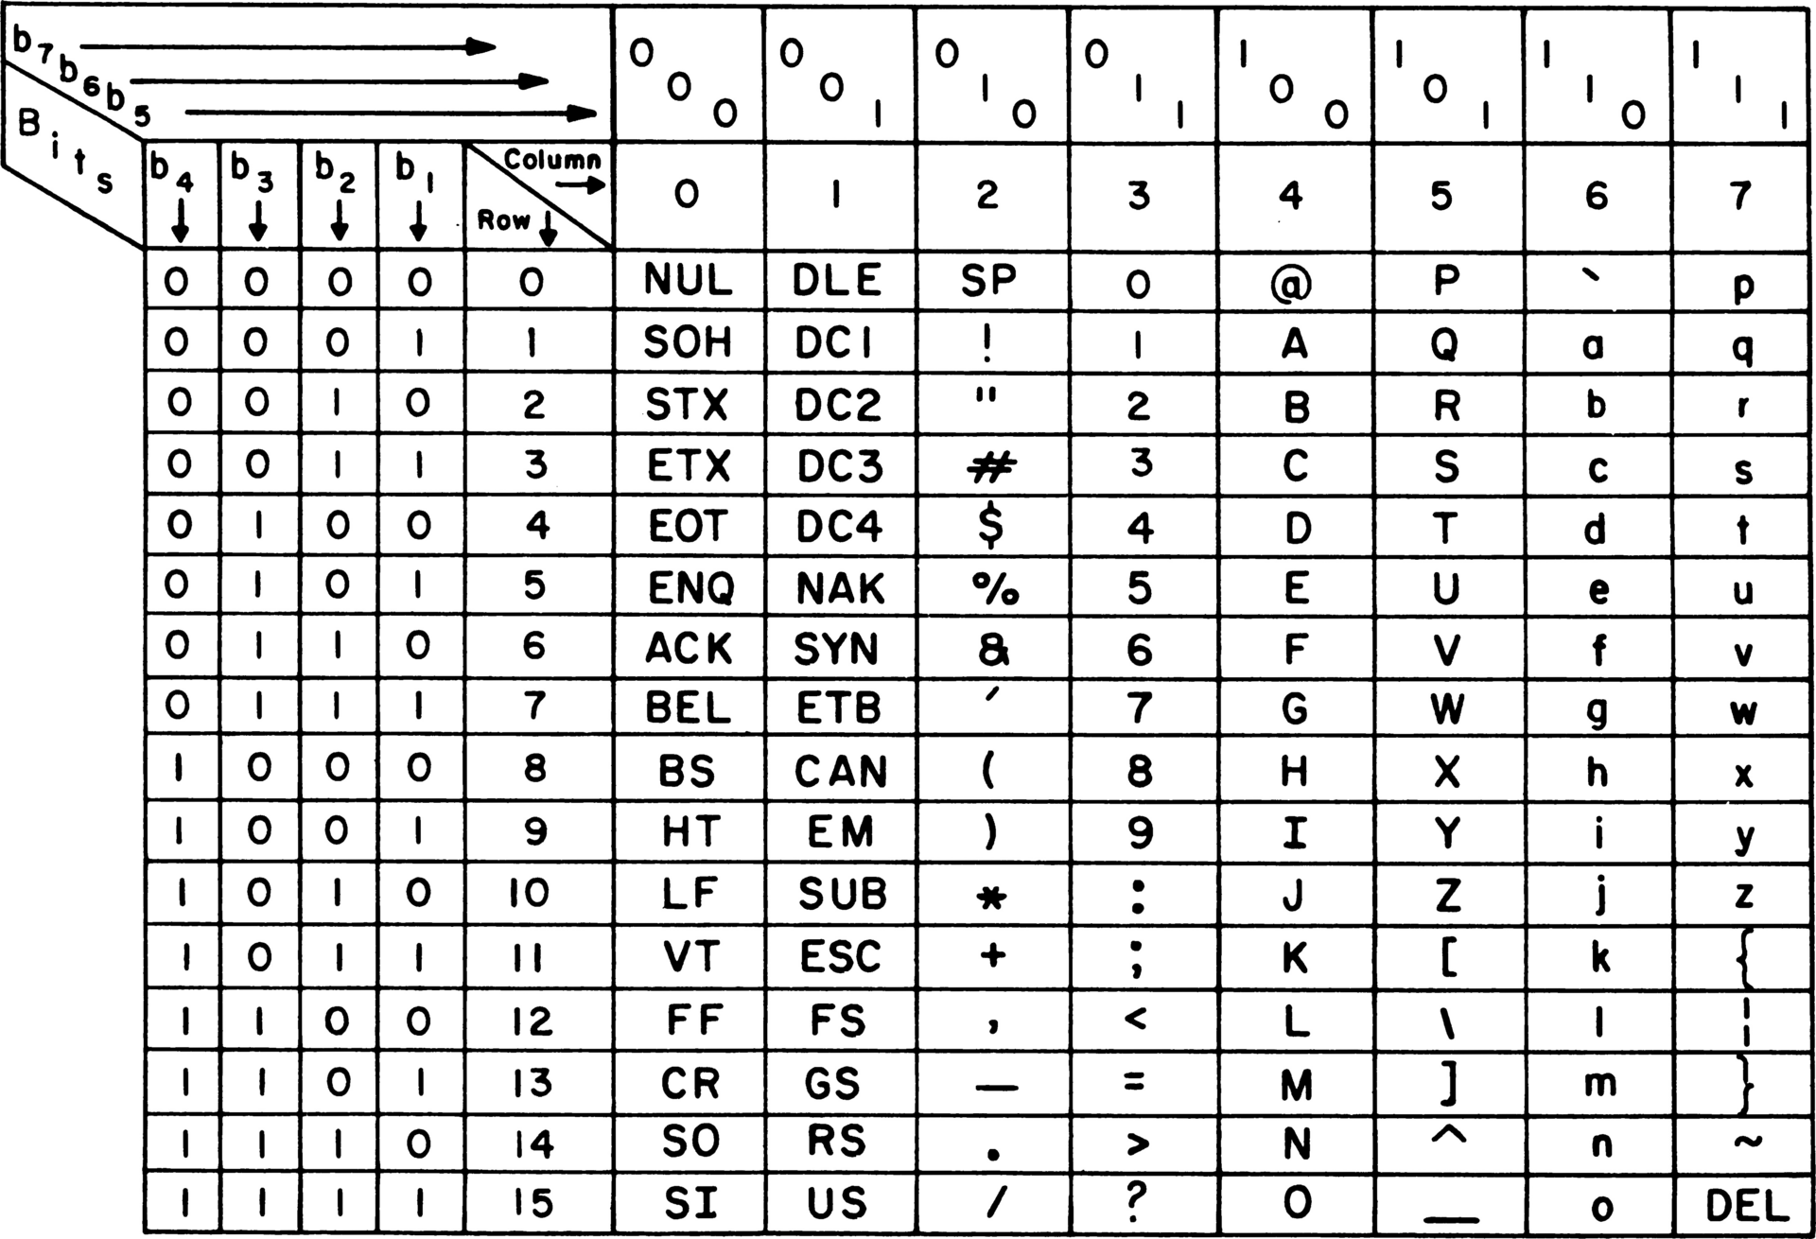
Encoding
Encoding maps every output to a binary code
Descending order of bits
100 0001 = A
110 0001 = a

Slide 8
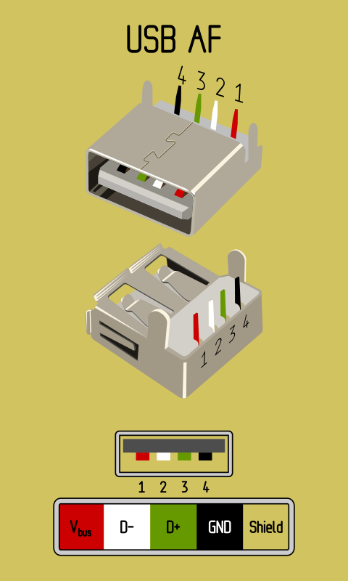
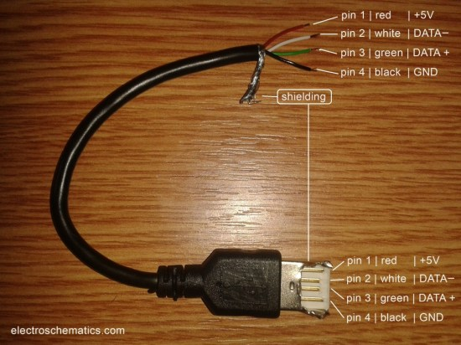
USB Pinout (Type A, USB 2.0)

Slide 9
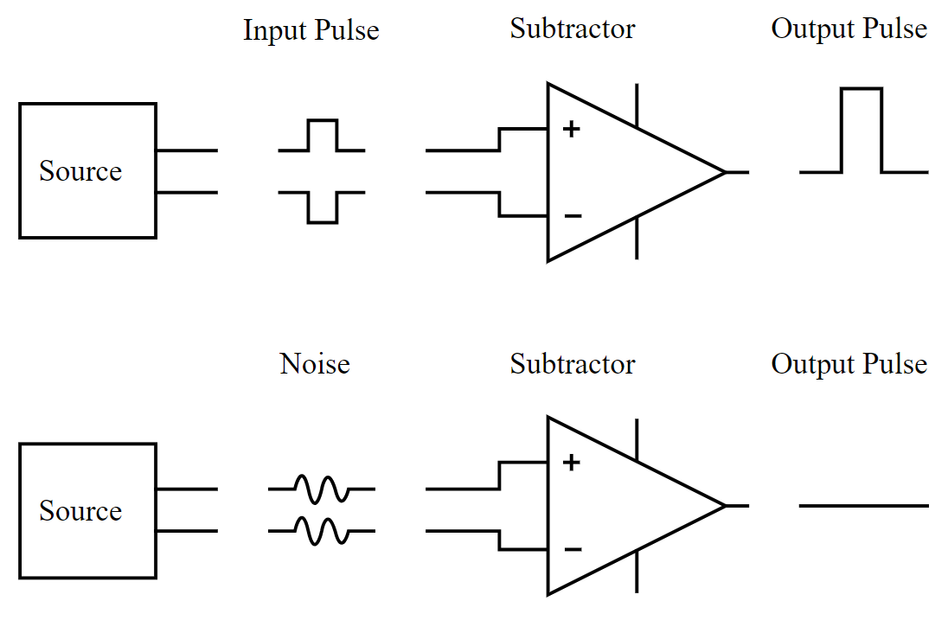
Differential Pairs
Electromagnetic interactions in nearby environment = noise
Differential pairs allow us to reduce signal noise by subtraction
Source is sent both as positive and negative
(+) – (–) = + for signal
(+) – (+) = 0 for noise
https://handwiki.org/wiki/images/3/3d/Differential_signal_and_common-mode_interference_fed_into_a_differential_amplifier.svg

Slide 10
Digital Input

Slide 11
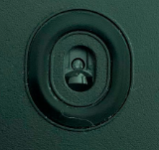
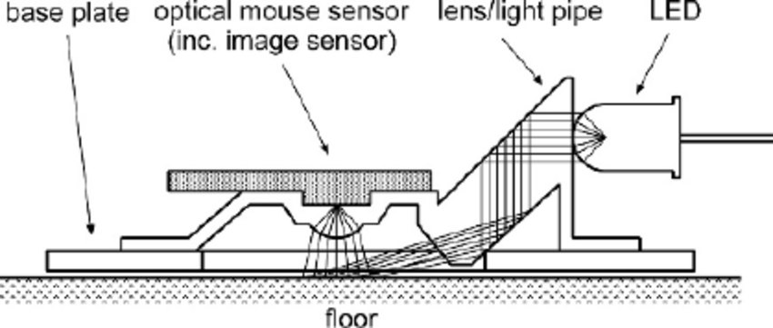
Optical Mouse Sensing
An LED illuminates the floor through a lens (UV light nowadays)
Mouse sensor captures low resolution picture constantly
Each polling tick, mouse looks at picture movement
https://www.researchgate.net/figure/Structure-of-optical-mouse-sensor_fig1_221644902

Slide 12


Optical Mouse Polling
Hertz = Cycles / Seconds
The faster the update cycles are, the smoother the cursor
Default USB polling is 125Hz = 0.8ms between updates
New USB allows up to 8000Hz!
An example image from a mouse sensor.
https://hackaday.com/2014/01/14/your-mouse-is-a-terrible-webcam/

Slide 13
A Problem With Keyboards…
A full-size keyboard has more than 100 keys!
Most microcontrollers don’t have so many inputs, and making them with so many is costly, so we need a better solution
We can design the inputs of a keyboard to overlap the same inputs on the keyboard’s microcontroller
This presents a problem we need to solve though…

Slide 14
Keyboard Ghosting
If a keyboard has too many keys held down, depending on design, it may not register an additional keypress
Try it out! Hold down a bunch of keys and see what happens
This keyboard blocking was created to prevent ghosting
Ghosting is when keys register which you haven’t pressed

Slide 15
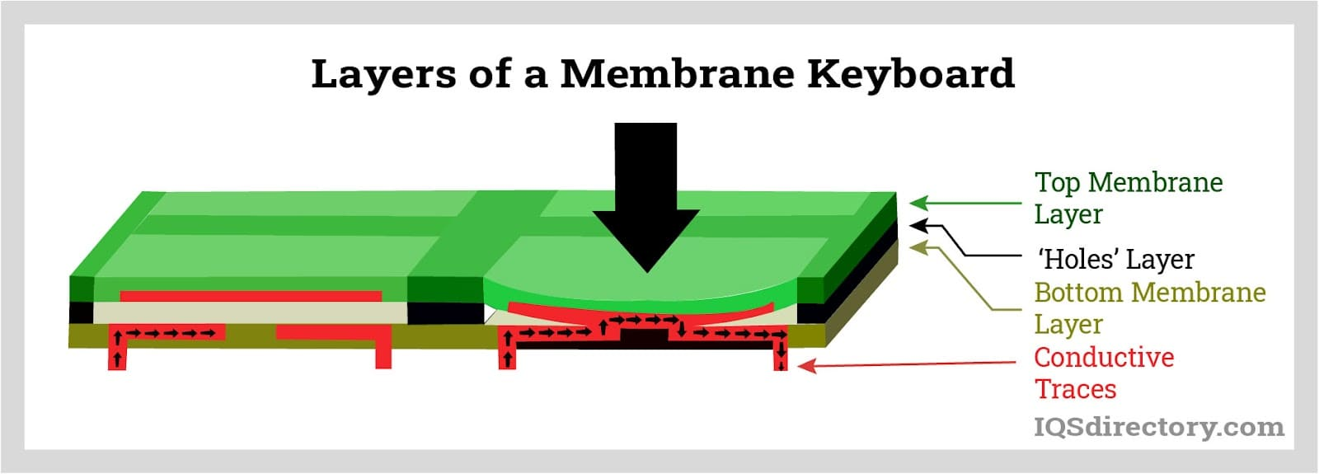
Keyboard Key Sensing
Pressure from key switches forces layers together to conduct
When you press far enough to establish a path, input occurs

Slide 16
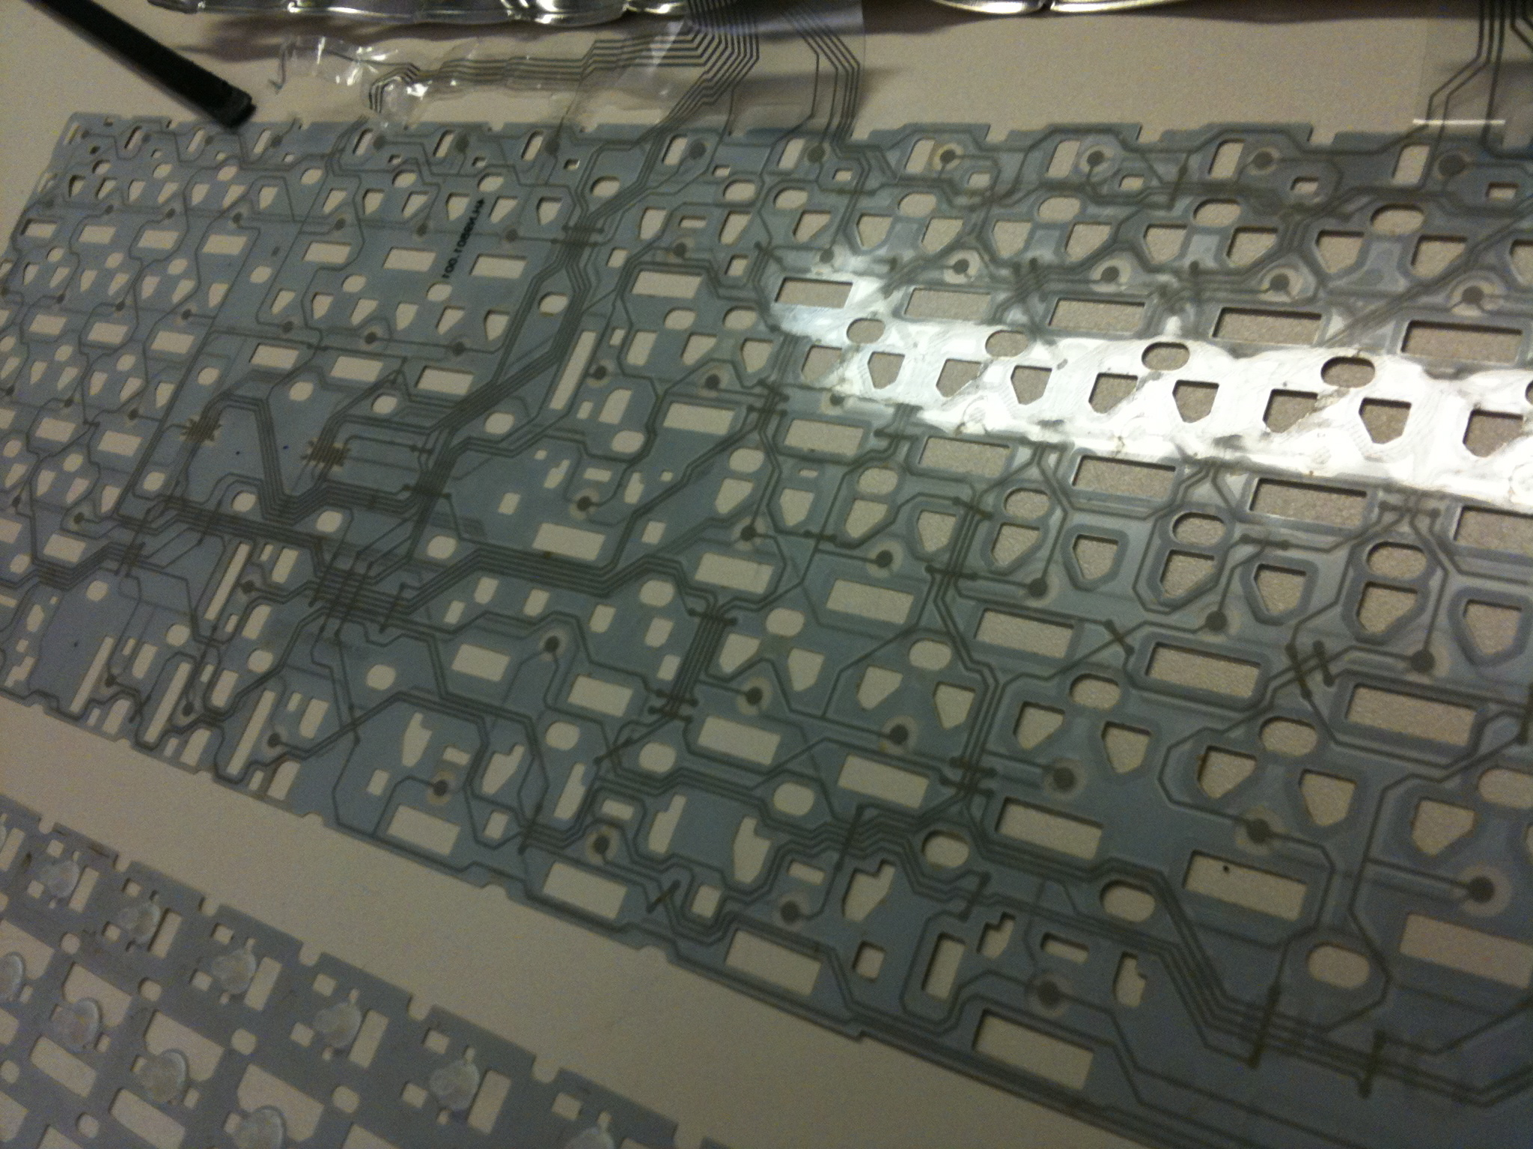
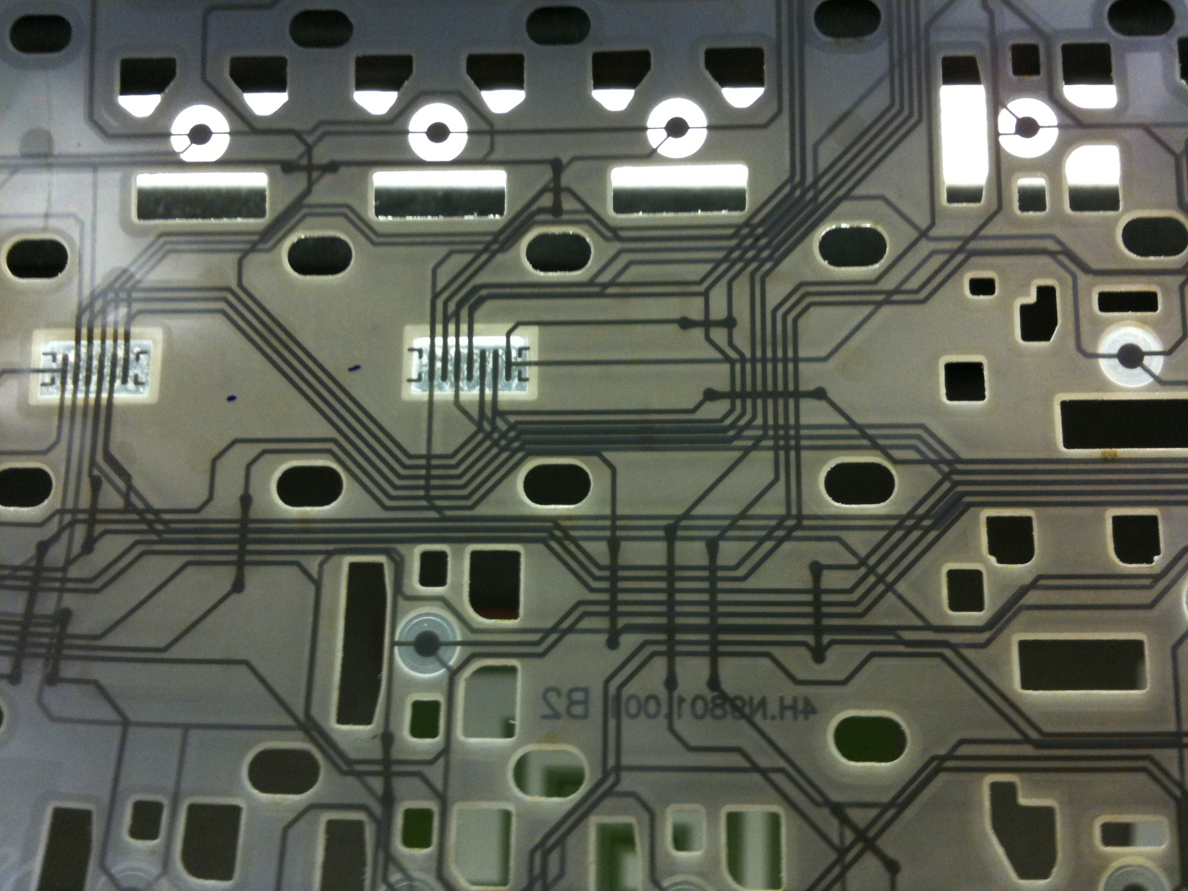
Keyboard Traces
PCB traces connect to make a large matrix of possible inputs
https://www.brunerd.com/blog/2009/08/25/apple-keyboard-a1243-disassembly/

Slide 17
Keyboard Matrix
Let’s imagine a square 4x4 keyboard with only 16 keys…

Slide 18
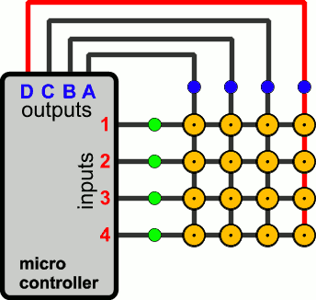
Keyboard Matrix
The controller cycles fast, scanning each column progressively
https://pcbheaven.com/wikipages/How_Key_Matrices_Works/

Slide 19
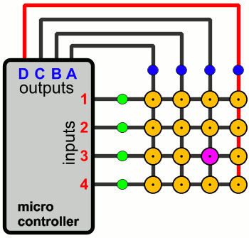
Keyboard Matrix
Each column scan is coded to interpret each possible input key
https://pcbheaven.com/wikipages/How_Key_Matrices_Works/

Slide 20
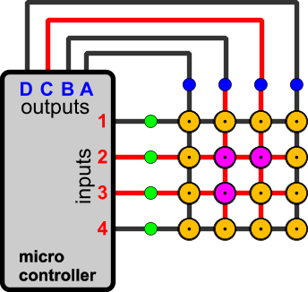
Keyboard Matrix
In this image B2, B3, and C2 are pressed, but C3 will register!
https://pcbheaven.com/wikipages/How_Key_Matrices_Works/

Slide 21
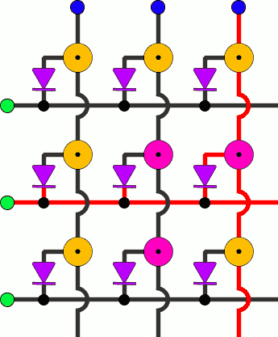
Keyboard Matrix
We can fix this design with diodes
Diodes are small and cheap pieces which only let current flow one way
Placing a diode on each switch prevents the backflow of voltage across the circuit causing ghosting
https://pcbheaven.com/wikipages/How_Key_Matrices_Works/

Slide 22
Digital Output

Slide 23
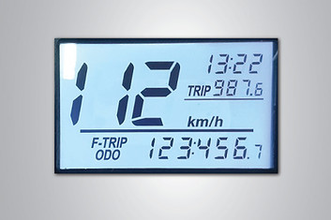
Binary to Decimal Conversion
LCD’s are everywhere in our life. One of the most common types is Twisted Nematic (or TN). We’ll see:
What makes it change color?
How do display a binary number?
https://www.newvisiondisplay.com/types-of-lcd-technology/

Slide 24
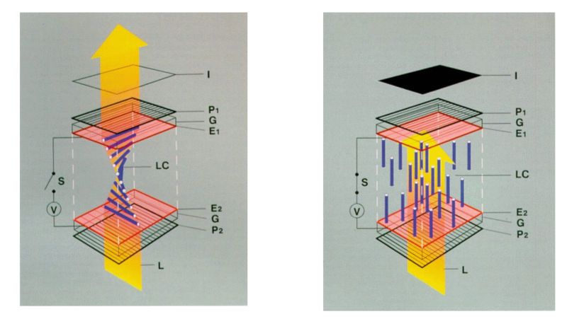
Twisted Nematic (TN) Displays
Very Cheap
Liquid Crystal Solution will align to voltage
Default twisted arrangement allows light to pass polarizers
Aligning to the charge blocks it!
https://commons.wikimedia.org/wiki/File:TN-LCD-schematic-MS-208kB.png

Slide 25
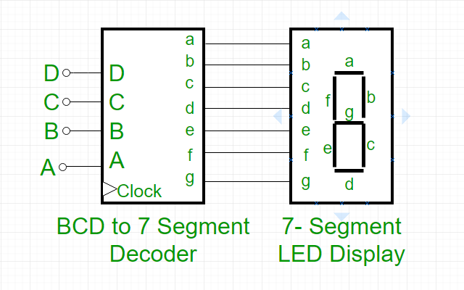
BCD to 7 Segment Display Decoder
4 bits are needed for 0-9
7 segments to display
Decoder must match for EVERY possible option
A truth table shows all possibilities for the code
https://www.geeksforgeeks.org/bcd-to-7-segment-decoder/#

Slide 26
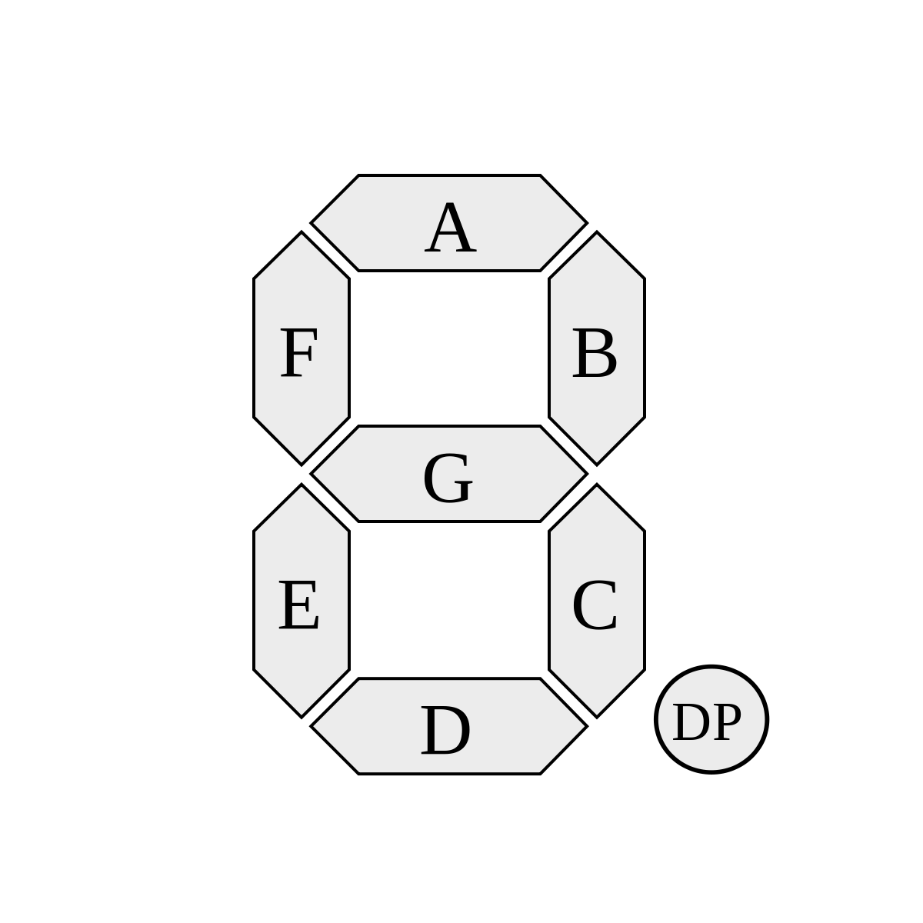
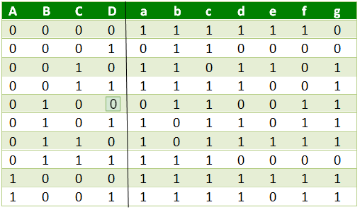
BCD to 7 Segment Truth Table
0123456789
https://www.geeksforgeeks.org/bcd-to-7-segment-decoder/#
https://commons.wikimedia.org/wiki/File:7_segment_display_labeled.svg

Slide 27
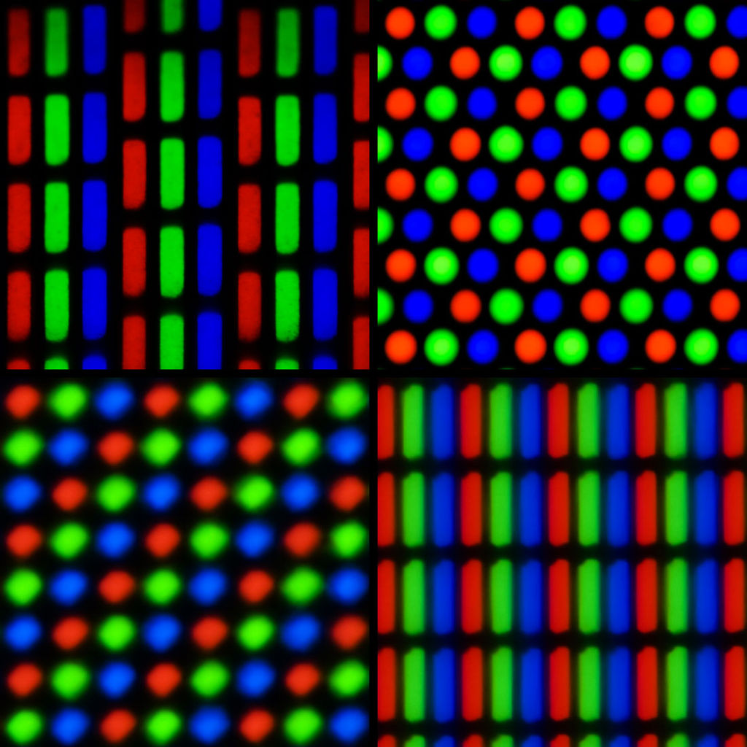
Pixels and Color
Red, blue, and green subpixels
Each one has brightness level
8 bit RGB gives 16 million colors
HD resolution has 2 million pixels
4K resolution has 8 million pixels
https://commons.wikimedia.org/wiki/File:Pixel_geometry_01_Pengo.jpg

Slide 28
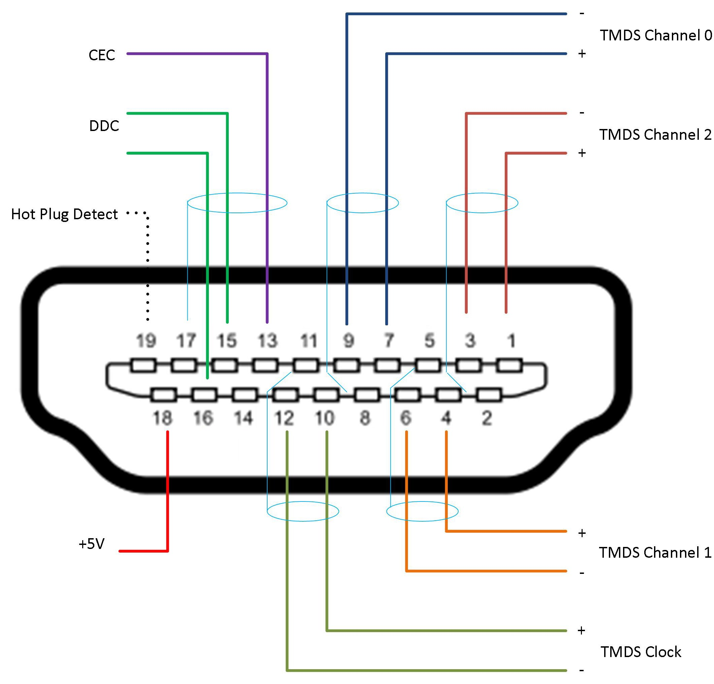
HDMI Cables
HDMI is a serial protocol, but with some parallel features
Parallel channels for Red, Green, and Blue subpixels
Data channels cycle to also transmit audio and data
https://commons.wikimedia.org/wiki/File:HDMI_Connector_Pins.jpg

Slide 29
Analog Audio

Slide 30
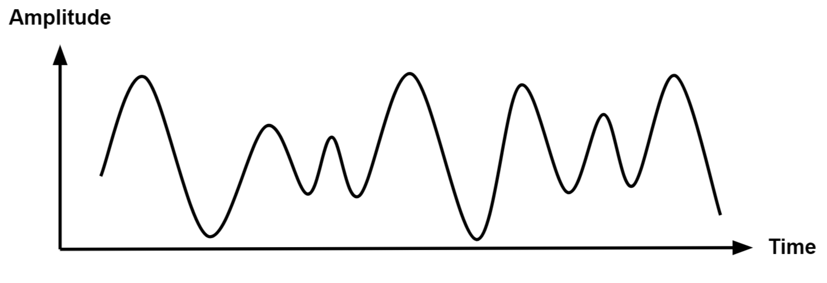
Analog Signals
The natural world is made of continuous analog signals
Sound waves are analog in nature, and must be made as such
https://www.monolithicpower.com/en/analog-vs-digital-signal

Slide 31
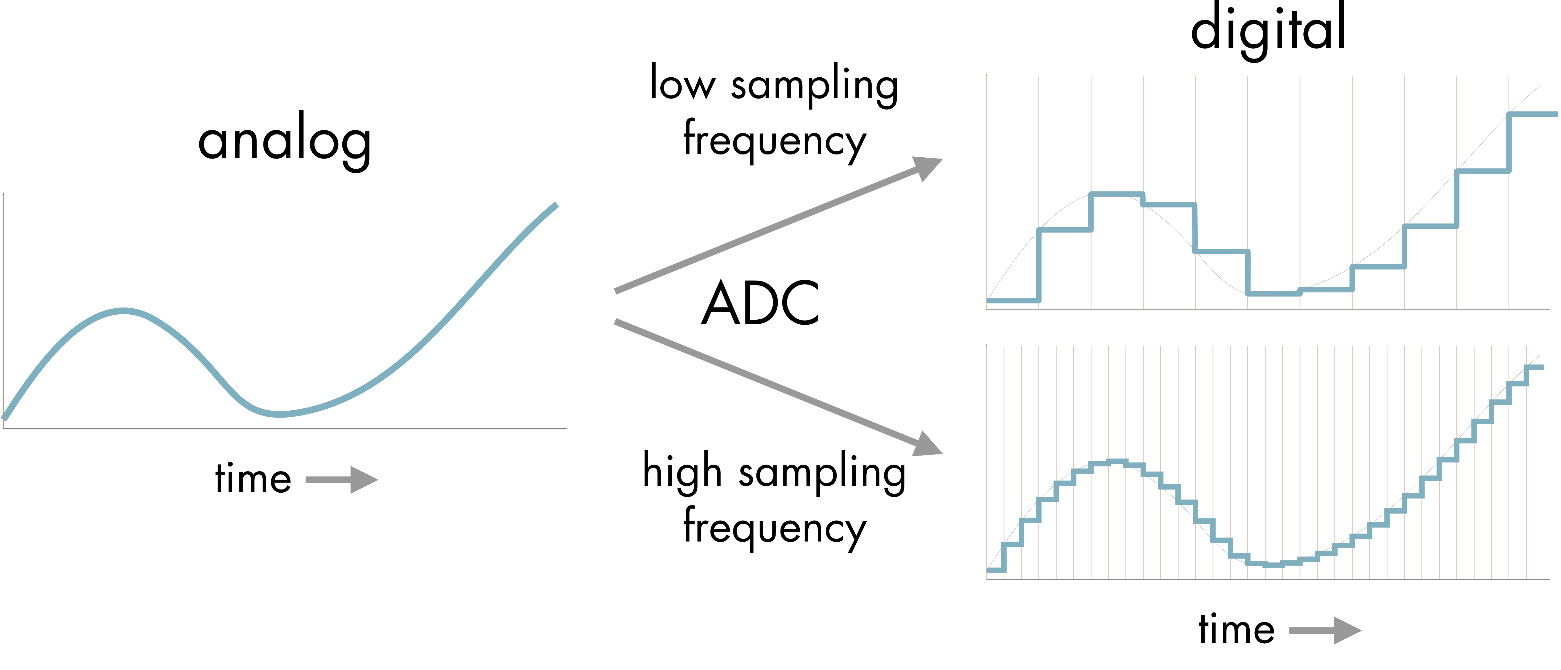
Analog to Digital Sampling
We have to sample an analog signal repeatedly to get a value
The frequency of the sampling is the sample rate (usually kHz)
The amount of possible steps we measure is our bit depth
CD’s run at
44.1 kHz
16 bit depth
https://neurotext.library.stonybrook.edu/C7/C7_1/C7_1.html

Slide 32
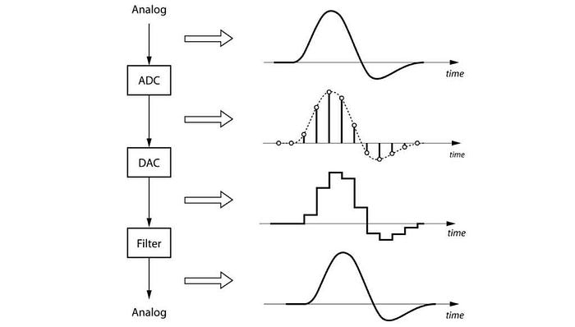
Usage in Audio
Microphones input analog sound
ADC converts it into a digital file
DAC and filters convert to analog
Your speakers amplify signal and play it as analog sound for you
https://medium.com/@graysparkpune/best-sound-engineering-academy-in-pune-gray-spark-academy-a30d74dac40e

Slide 33
Conclusion

Slide 34
Conclusion
We need to represent all our data in binary numbers and codes
Generally, serial communication is used to transfer our data
Mice take pictures and compare them to track your movement
Keyboards need to scan for key presses in a large matrix
LCD displays align with voltage applied to match a color input
HDMI outputs map to a large grid of RGB subpixels on screen
Analog signals must be used for natural waves like sound
Analog mic input is sampled to digital to make a sound file
Sound files are converted to analog waves on speaker to play

Slide 35
Next Events

Slide 36


Slide 37
